Slide 1

Fast N² t-distributed Stochastic Neighbor Embedding Andreas Blöchinger Marc Fischer Alberto Montes Marko Taubner
TexPoint fonts used in EMF.
Read the TexPoint manual before you delete this box.: AAAAA

Slide 2
Algorithm
Notes:
Don’t spend any time here
This I just to show the algorithm as it is in the literature
10s

Slide 3
Algorithm on MNIST
Notes:
We have images of handwritten number (0 -9)
They are very high dimensional vectors (784) and we don’t know any thing about the structure.
The Algorithm gives us a low dimensional picture of the groups in that data set.
Used for exploration in machine learning.
20s

Slide 4

Algorithm as we implemented it
Part 1
Part 2
Part 3
Notes:
Our algorithm.
Roughly describe parts.
We use float.
1 min

Slide 5
Experimental Setup
Euler III: Intel Xeon E5-1585Lv5 3.0 GHz
Architecture: Skylake (AVX2.0)
Cache:
L1 Cache: 32 KB
L2 Cache: 256 KB
L3 Cache: 8 MB
Compiler: ICC 16.0
Notes:
We use icc because the exp_ps intrnsic is only avaiable there

Slide 6

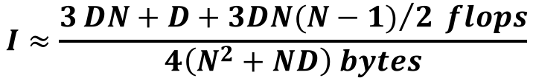
Part 1: Data preprocessing
$$I≈\frac{3{DN+D+3DN(N−1)}/2 flops}{4\left(N^{2}+ND\right) bytes}$$
Notes:
Remember: We use float.
The red and violet line are almost the same – we use the violet version because it is better for lower N and higher D which both valid cases.
Depending on D we can also get to ~20 FLOP, but 15-16 is the usual case.
The best possible for the isntruction mix is a upper bound based on the inner loop. Likely it is less.

Slide 7
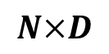

Part 1: Optimized Version, Normalization
float *X =
$$N×D$$
x_{0,0}
x_{0,1}
x_{0,2}
x_{0,3}
x_{0,4}
x_{0,5}
x_{0,6}
x_{0,7}
x_{1,0}
x_{1,1}
x_{1,2}
x_{1,3}
x_{1,4}
x_{1,5}
x_{1,6}
x_{1,7}
$$D$$
float *means =
runningMax[0:7] = 0
for k=0:8:D
accum0[0:7] = 0 ... accum7[0:7] = 0
for i=0:8:N
accum0[0:7] += X[i][k:k+7]
...
accum7[0:7] += X[i+7][k:k+7]
Reduce accumuators into means
Multiply means with 1/N
for i=0:8:N
X[i][k:k+7] -= means[k:k+7]
runningMax = max(runningMax, abs(X[i][k:k+7]))
Notes:
we access each data point and read 8 dimensions
We add all dimensions and divide them by the points
Then we substract the new mean from all data points (in that dimensions) and keep a running maximum
At the end we have 8 maximums We reduce them to 1 maximum to use as a factor in the next step
45 s

Slide 8


Part 1: Optimized Version, Distance
float *X =
$$N×D$$
x_{0,0}
x_{0,1}
x_{0,2}
x_{0,3}
x_{0,4}
x_{0,5}
x_{0,6}
x_{0,7}
x_{1,0}
x_{1,1}
x_{1,2}
x_{1,3}
x_{1,4}
x_{1,5}
x_{1,6}
x_{1,7}
for i=0:8:N
for j=i+8:8:N
for i'=i:i+8
accum0[0:7] = 0 ... accum7[0:7] = 0
for k=0:8:D
dist0[0:7] = X[i][k:k+7]
- X[j][k:k+7]
accum0[0:7] += dist0*dist0
...
dist7[0:7] = X[i+7][k:k+7]
- X[j+7][k:k+7]
accum7[0:7] += dist7*dist7
Reduce 8 accums into res[0:8]
Multiply by factor
Store res as 1 row in upper block
Transpose 8 rows and store lower block
float *DD =
$$N$$
$$N$$
Notes:
We access data in 8x8 blocks
This gives locality within X and DD
Within those 8x8 blocks we access data in 8 dimension strides
This allows unrolling with 8 accumulators and the use of FMAs
45s

Slide 9
Part 2a: High dimensional affinities
Notes:
9

Slide 10
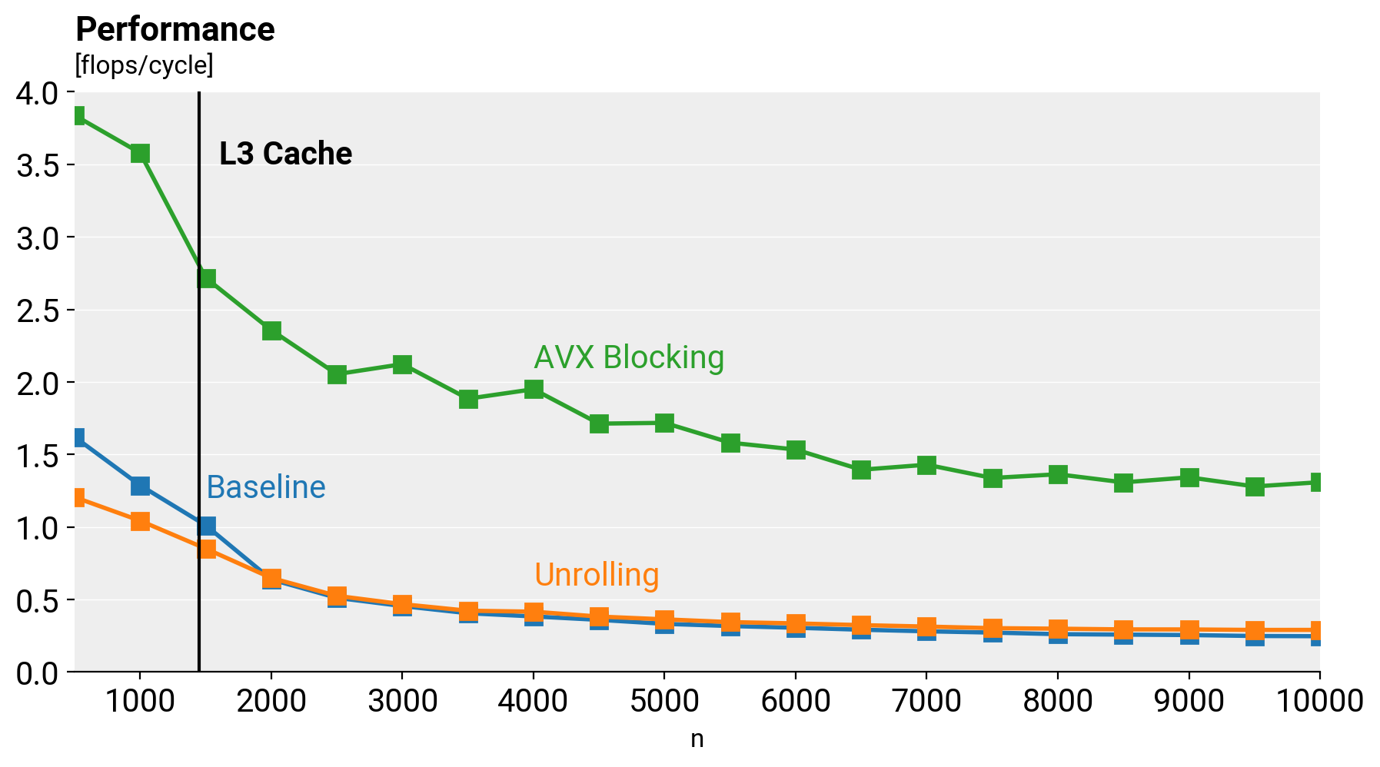
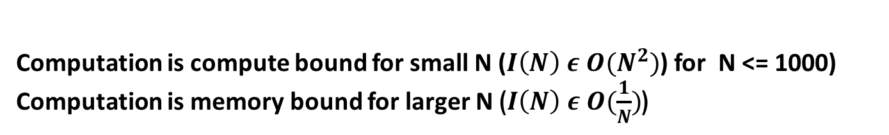
Part 2b: Symmetrize affinities
Computation is compute bound for small N ($I\left(N\right) ε O(N^{2})$) for N <= 1000)
Computation is memory bound for larger N ($I\left(N\right) ε O(\frac{1}{N})$)
Notes:
We are using 8*8 blocking for avx as we are trying to deal with N stride access -> pij = pji + pij
we are storing the sum of the computed symmetrized pij on the fly and using the last loop for computing the early exageration(multipication by a constant) and normalization by the computed sum -> using avx vectors for that. we are using fms and ilp for computing within the blocks of symmetrization (as we have crssoings for the blocks that contain diagonal elements)
performance: not as good as expected (8* speedup expected, but 4 times got) as we are using a lot of set ps instructions which are very costly -> idea with using transpose of 8*8 block is a way to go
10

Slide 11
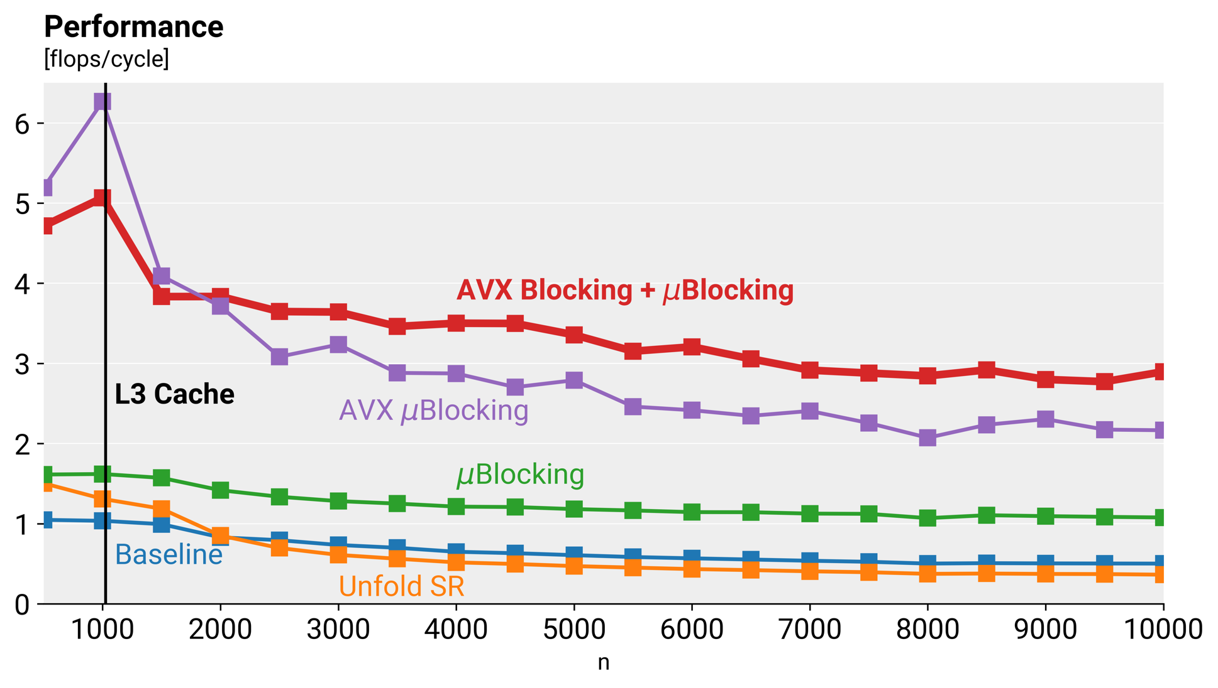
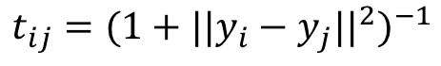
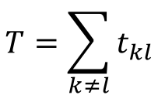
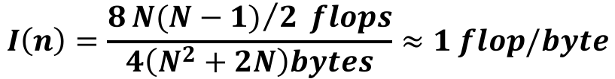
Part 3: Training Loop
Computation Low Dimensional Affinities
$$t_{ij}={(1+{||y_{i}−y_{j}||}^{2})}^{−1}$$
$$T=\sum_{k≠l}{t_{kl}}$$
$$I\left(n\right)=\frac{8{N(N−1)}/2 flops}{4\left(N^{2}+2N\right)bytes}≈1 flop/byte$$
Notes:
The first step on the training loop consist on computing the low dimensional affinities on the embedded space which is 2 dimensional.
To compute it, it has been use the same approach previously used to compute the pairwise Euclidean distances for high dimensional vector but in this case, as the data has only 2 dimensions, the operational intensity is 1 and the performance memory bound.
The first approach to optimize the baseline code was to unfold the inner loops and use scalar replacement, but perform well for low input sizes but for larger ones perform worst than the baseline.
The a microblocking completely unfolding an 8x8 pairwise points distance computation which let to better results.
Vectorising this code improves even more the performance but the best performance of all is using a two level block (first 32x32 and inside this block compute by microblocks of 8x8).

Slide 12
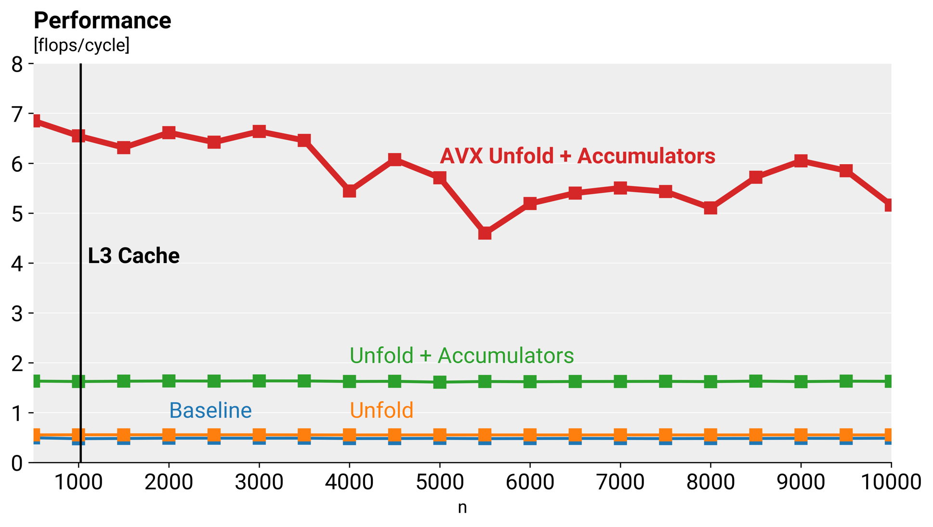
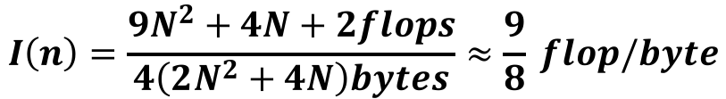

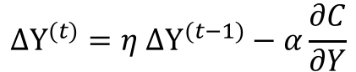
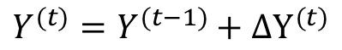
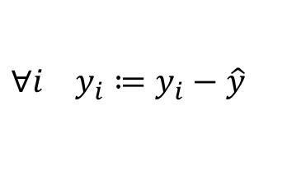
Part 3: Training Loop
$$\frac{∂C}{∂Y}=\sum_{j}{\left(p_{ij}−\frac{t_{ij}}{T}\right)\left(y_{i}−y_{j}\right)t_{ij}}$$
Gradient Computation, Update and Normalize
$$ΔY^{(t)}=η ΔY^{(t−1)}−α\frac{∂C}{∂Y}$$
$$I\left(n\right)=\frac{9N^{2}+4N+2flops}{4\left(2N^{2}+4N\right)bytes}≈\frac{9}{8} flop/byte$$
$$Y^{(t)}=Y^{(t−1)}+ΔY^{(t)}$$
$$∀i y_{i}≔y_{i}−\hat{y}$$
Notes:
The second part of the training loop, is given the pairwise affinities of the original space and the affinities of the embedding space previously computed, it computes a gradient for each point and update each point taking into account a momentum. Finally at the end of each training loop the embedding space has its mean subtracted.
The first approach to improve the baseline has been to unfold the inner loops which improvement is insignificantly. The next approach has been to keep accumulators for the gradient computation and mean computation and the last one which gave the best results was using AVX registers to store the accumulators.

Slide 13
Overall
Insert overall performance plot
Notes:
Again we use float.

Slide 14
After this slide are the original templates
Nothing to see here

Slide 15
General Remarks
You have exactly 10 minutes! (typically this means 7–8 slides)
Get ppt 2007 or later – it is worth it
Use proper visuals as much as possible, avoid text-only slides
Don’t put an overview or organization slide – the talk is too short
For the very motivated, check out this small guide http://people.inf.ethz.ch/markusp/teaching/guides/guide-presentations.pdf

Slide 16
Typical Organization I
Algorithm that you consider (maybe 2 slides)
State problem that it solves (input:…, output: …)
If possible visualize how it works or show high-level pseudocode
State asymptotic runtime
Cost analysis (cost measure, exact count)
Baseline implementation (briefly explain), maybe show already performance plot and extract percentage of peak
Optimizations you performed
Briefly discuss major optimizations/code versions
Maybe explain the most interesting in a bit greater detail
Any analysis (e.g., profifling) you performed is interesting – show the result
If too much, explain only some things and just state the rest

Slide 17
Typical Organization II
Experimental results
Very brief: Experimental setup (platform, compiler)
Performance plot over a range of sizes with different code versions
Extract overall speedup
Every project is different – so adapt as needed
Focus on the most interesting things, don’t explain everything that will be in the final report.

Slide 18
Try to Make Nice Plots
DFT 2^{n} (single precision) on Pentium 4, 2.53 GHz
[Gflop/s]
Spiral SSE
Intel MKL
Spiral C vectorized
Spiral C
n

